Slide 1
Enhancing Autonomous Vehicle Perception in Adverse Weather
Team Members:
Saeah Go, Max Rego, Artem Suprun, Filipp Suprun
Notes:
(20 sec)

Slide 2
The Problem - Why it is interesting?
What is traffic sign recognition?
A critical component of autonomous driving systems
Vehicles rely on accurate sign recognition to navigate safely, follow speed limits, and make crucial driving decisions
What is the problem?
Current autonomous driving systems perform poorly in uncontrolled environments (They work well only in specific conditions like clear weather, straight roads, and no occlusions)
In Portland, we often have rain and fog during fall and winter, and sometimes snow — which degrades performance
Why it is interesting?
Considering these real-world conditions is essential for safe and widespread adoption of autonomous vehicles
Goal: Compare how different weather simulations affect model performance
Notes:
(1 min 15 sec)
Traffic sign recognition is a critical component of autonomous driving systems. Vehicles rely on accurate sign recognition to navigate safely, follow speed limits, and make crucial driving decisions.
However, the problem arises when autonomous systems operate outside controlled environments. Many models are trained on clear, high-quality images, but real-world conditions introduce challenges like fog, snow, rain and other occlusions that degrade performance.
Improving model robustness under these conditions is essential for the widespread adoption and safety of autonomous vehicles.

Slide 3
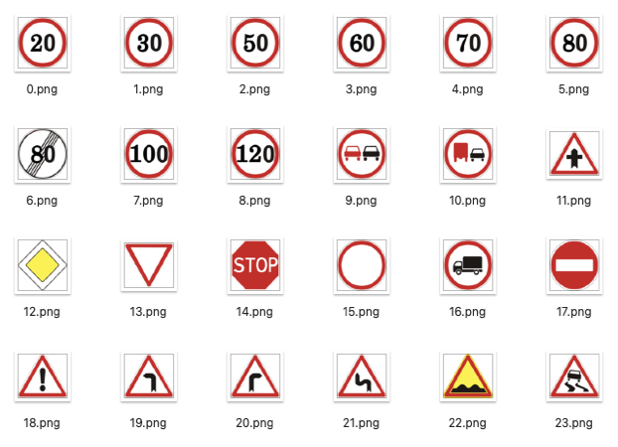
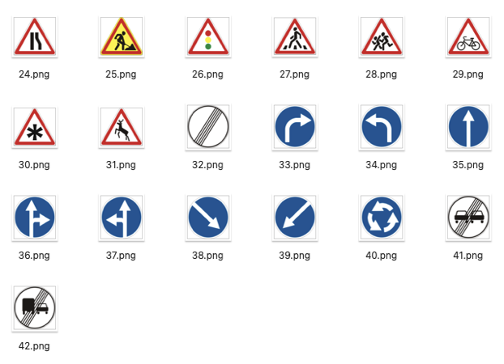
Method
Dataset: German Traffic Sign Recognition Benchmark (GTSRB)
Data Preparation:
Baseline: Original traffic sign images
Obscured: 3 weather cases (rain, fog, and snow)
Model:
CNN (ResNet50)
Transfer Learning (Pretrained CNN model)
Evaluation Metrics:
Accuracy, precision, recall, and f1 score
Notes:
(35 sec)
For this project, we used the German Traffic Sign Recognition Benchmark (GTSRB) dataset.
The baseline dataset consisted of clear, original traffic sign images.
The obscured dataset was created by applying 3 different types of obscuration techniques, such as rain, fog, and snow.
We built a CNN model using the original dataset first, and we used transfer learning with obscured image data.
To evaluate model performance, we used test accuracy, and f1 score as our key metrics.

Slide 4
Pre-Trained CNN Model
Our initial approach to addressing this problem was to use transferred learning, which involves:
Using a pre-trained CNN model (ResNet50) to classify the data.
Using the pre-trained model as the base model for the transfer learning.
The pre-trained model alone wouldn’t be capable of classifying the weather data, because it wasn’t originally trained for that task, which is why we needed to perform transfer learning onto it. We want the learned features that it has, so we could reuse it for our case.
We chose the ResNet50 model due to its proven performance on image classification, and how it was trained on a wide range of features and patterns.

Slide 5
Transfer Learning
Transfer learning is a technique, where a model trained on one task is repurposed for another.
How this helps:
We don’t require as large of a dataset.
We can leverage previous learned weights to speed up learning time.
Useful for applying specificity to existing analysis.

Slide 6
Obscured Dataset Preparation
As previously stated, the datasets we plan to use are:
GTSRB dataset (which contains the traffic signs)
Snow100k, Rain100k, and Foggy Cityscape
The GTSRB dataset is self explanatory, but the reason why we’re also using the snow, rain, and foggy datasets is because we plan to use those datasets to help generate images with the adverse weather conditions, for testing purposes.
We plan to use augmented images to help test the model:
25% obscurations
50% obscurations

Slide 7



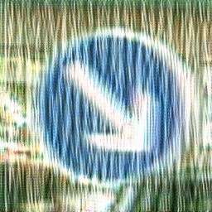
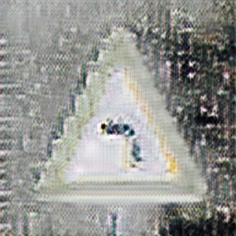
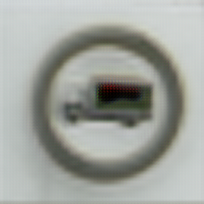

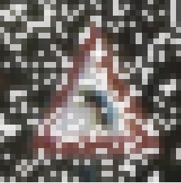

Weather Simulation Methods
Original:
We decided on having two methods of generating the data with weather effects:
Using a custom method of augmenting the images.
Using an image generating method, CycleGAN.
CycleGAN:
Custom:

Slide 8
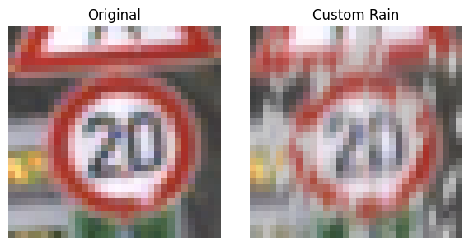
Simple Weather Simulation
We used custom image filters to simulate weather effects on traffic sign images.
Approach
Rule-based manipulation using OpenCV and NumPy (not deep learning)
Simulated fog using white overlay blending
Simulated rain by drawing random line segments with motion blur
Simulated snow by adding random white pixels with Gaussian blur
Filters were handcrafted and visually tuned for realism
Allowed full control and fast generation of diverse test data
Notes:
(1 min)
For our Simple Weather Simulation, we used custom image filters to create weather effects on our traffic sign images for testing.
This method is based on traditional computer vision techniques, rather than deep learning. We applied rule-based filters using tools like OpenCV and NumPy to simulate weather conditions.
For example, we used Gaussian blur and brightness reduction to simulate fog, and white noise and streak patterns to create rain and snow effects.
These filters were hand-crafted and tuned visually to ensure the transformations looked realistic and would meaningfully test model robustness.
This approach gave us full control over the obscuration effects and allowed us to generate a wide variety of modified test data without training another model.

Slide 9
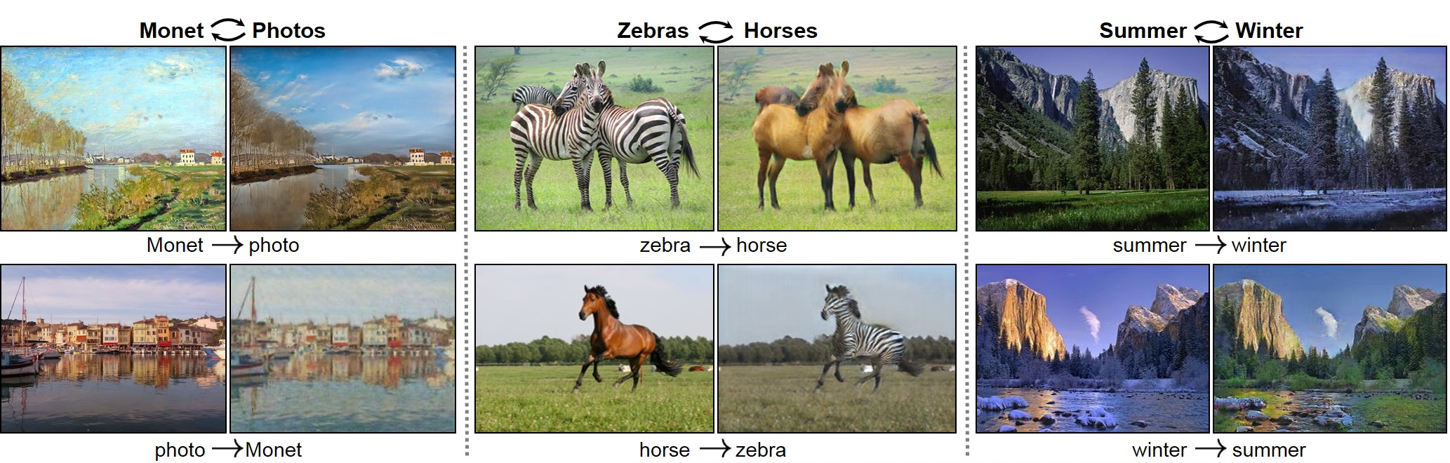
CycleGAN
Original
“Foggy”
We used CycleGAN to modify our images for testing.
About
Image-to-image translation, applying details to another image.
Learns off of a dataset of images.
Training
Done off Snow, Rain, and Fog dataset.
Converted our images to images with effects.

Slide 10
Results
CycleGan Modifications
Weather / Method | Accuracy | Precision | Recall | F1-Score
Original (Baseline) | 99.13% | 98.76% | 98.76% | 98.74%
Rain - 25% | 93.29% | 94.22% | 93.29% | 93.50%
Rain - 50% | 88.59% | 91.03% | 88.59% | 89.09%
Fog - 25% | 75.21% | 77.41% | 75.21% | 75.75%
Fog - 50% | 51.39% | 56.47% | 51.39% | 52.67%
Snow - 25% | 92.83% | 93.73% | 92.93% | 92.96%
Snow - 50% | 87.76% | 89.94% | 87.76% | 88.01%
After a run of testing with ResNet50, here is what we found
Observations:
Model maintained high performance on mild amounts of obscured data, accuracies above 90% for most CycleGAN.
Severe amount of distortions led to noticeable drops in accuracy and F1-score, especially with the custom distortions.
CycleGAN-obscured images generally resulted in better performance compared to the custom weather-like distortion method, particularly for moderate to high distortion levels.
The model underperformed with CycleGAN fog, and weather-like rain and snow.
Weather-Like Distortions
Weather / Method | Accuracy | Precision | Recall | F1-Score
Original (Baseline) | 99.13% | 98.76% | 98.76% | 98.74%
Rain - 25% | 83.10% | 90.12% | 83.10% | 85.06%
Rain - 50% | 65.95% | 83.48% | 65.95% | 69.97%
Fog - 25% | 97.69% | 97.69% | 97.69% | 97.69%
Fog - 50% | 96.42% | 96.61% | 96.42% | 96.42%
Snow - 25% | 81.86% | 91.78% | 81.86% | 85.02%
Snow - 50% | 63.75% | 86.85% | 63.75% | 70.25%

Slide 11
Conclusions
What we concluded using our initial approach:
Transfer learning had enabled robust recognition of traffic signs under mild distortions.
Model’s performance shows a significant degrade in performance under heavy distortions.
While the results show some promise, some things still need to be tuned in to improve the model’s performance. (As seen for the foggy performance)
The shape of the object may have a big impact on performance.
This had highlighted the importance of having a diverse training dataset.

Slide 12
Next Steps
Couldn't be done due to time constraints:
Fine tuning the obscured images to get the best result using transfer learning
Figuring out why CycleGAN fog dataset has such bad results.
Next Steps:
Analyzing the results in much more detail
Explore potential solutions such as domain adaptation techniques.
Train the model on more diverse datasets to help improve the performance.

Slide 13


Questions?

Slide 14
Thank you

